Slide 1

FY19-20 Berkeley
County Budget
May 28, 2019

Slide 2
FY20 General Fund Budget Highlights
Supervisor’s budget is balanced without the use of fund balance
Reassessment / Rollback Millage Calculation
Establishes the following New Departments
  Grants - 1 new employee funded by GF @ 25% of FY20, CDBG funded FY21 forward
  Tourism - 1 new employee funded by accommodations tax
  Radio Department - moves 1 current employee from IT Department
  Animal Control Division - moves 4 current employees from Animal Services to Sheriffs Office
Funds critically needed software:
  Property tax software to replace 1980’s program
  Business Intelligence software to replace Excel spreadsheet programs
Adds new positions at no additional cost due to savings from eliminated positions
Notes:
Excel programs are calculating Personnel expense for the budget each year, FILOT distribution, Water & Sanitations entire budget including capital equipment and CPI portion along with both financial reports being manually keyed in each month.

Slide 3
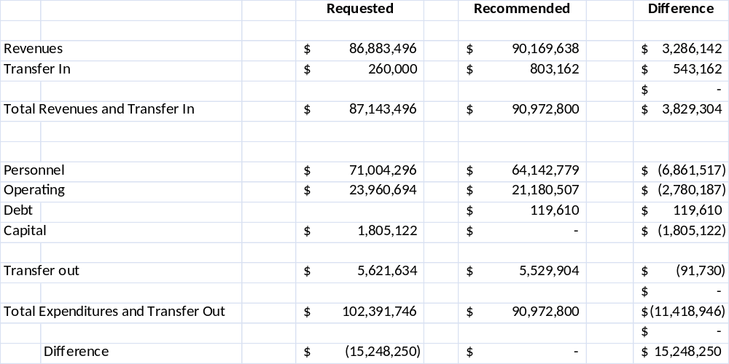
FY20 General Fund Overview

Slide 4
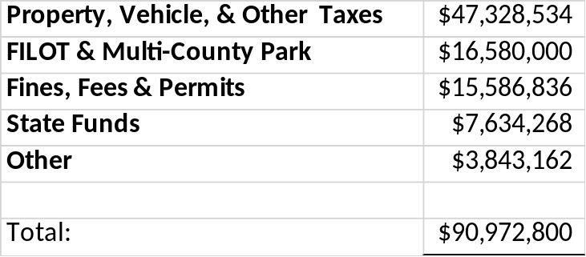

Slide 5
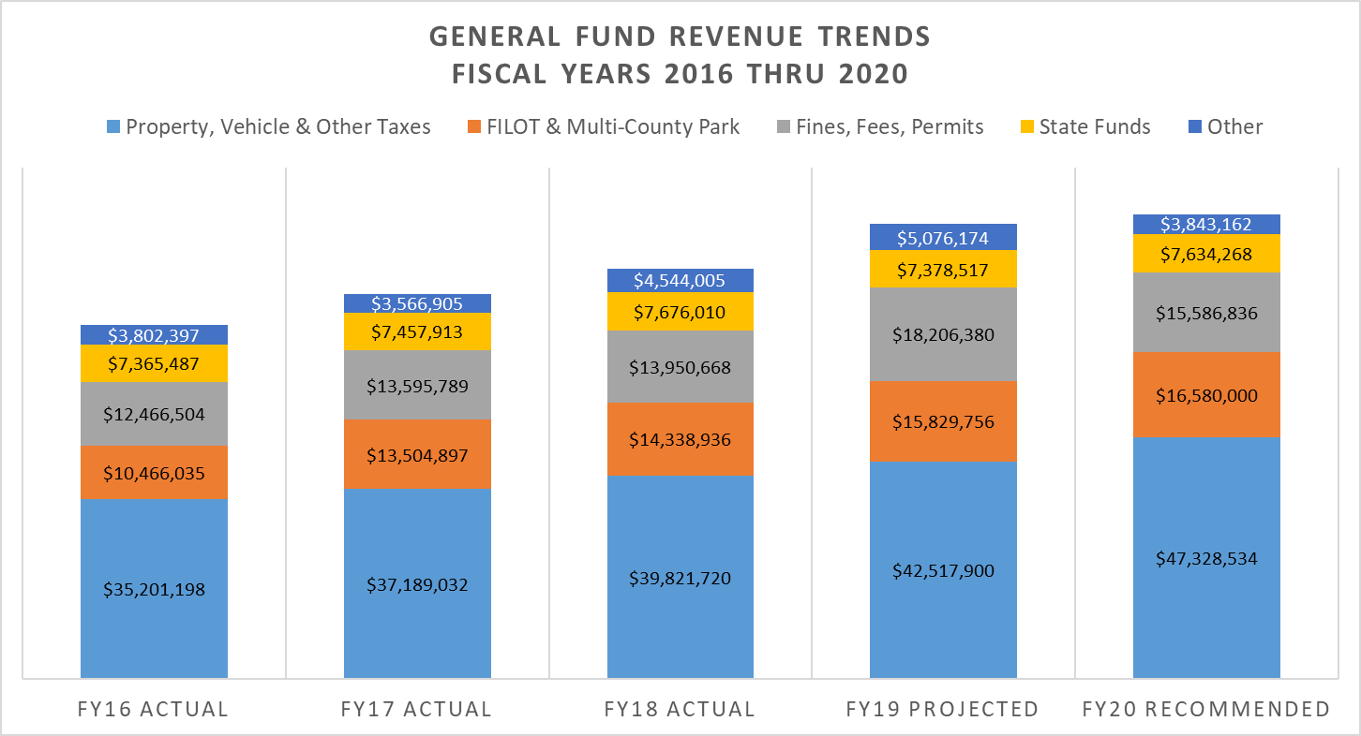
$89,008,727
$90,972,800
$80,331,339
$75,314,536
$69,301,621

Slide 6
FY20 Revenue Changes – Rollback Millage
Reassessment - rollback millage calculation must be performed.
Rollback millage uses the following formula:
  Prior Year Taxes Collected / Assessments – Growth (new property)
Population Growth & CPI
  Provided by SC Assc of Counties
  Added to the rollback millage rate to determine maximum allowable millage rate. (CPI=2.44%, Growth = 3.09% = Total of 5.53% increase or 2.3 mills)
Rollback millage + CPI & Growth = 44.3 max mills
Supervisors recommendations is 43.0 mills.
  Represents a 2.0 mill rollback from our current 45.0 mills.

Slide 7
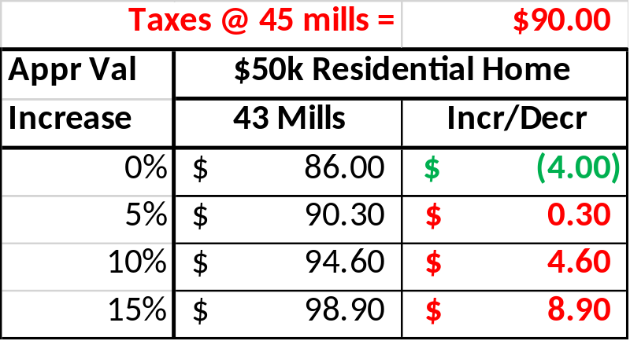
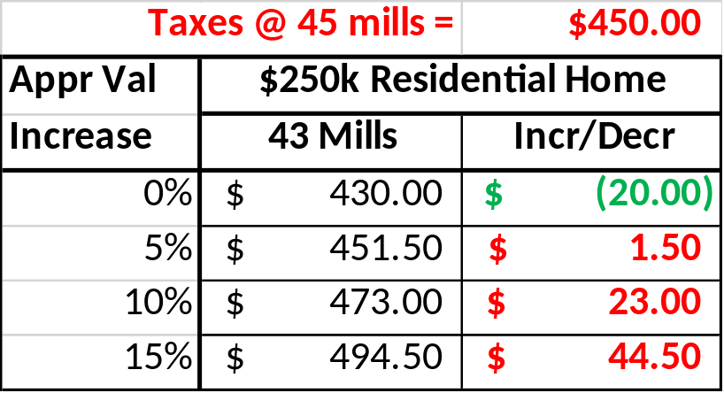
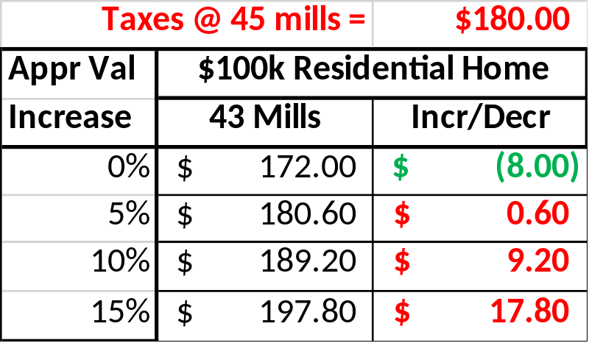
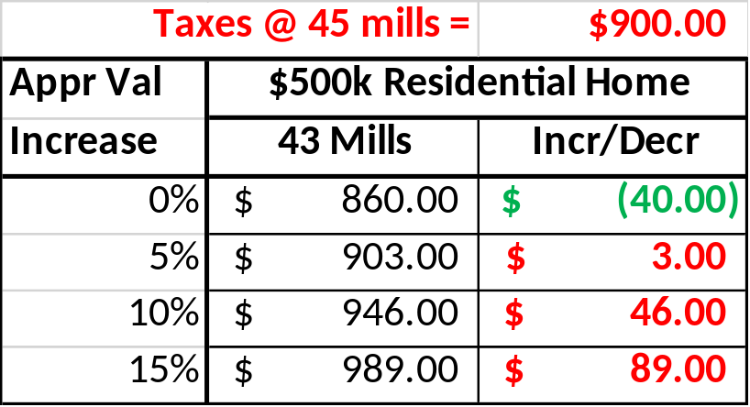
Result of Millage Reduction –County Operating Taxes

Slide 8
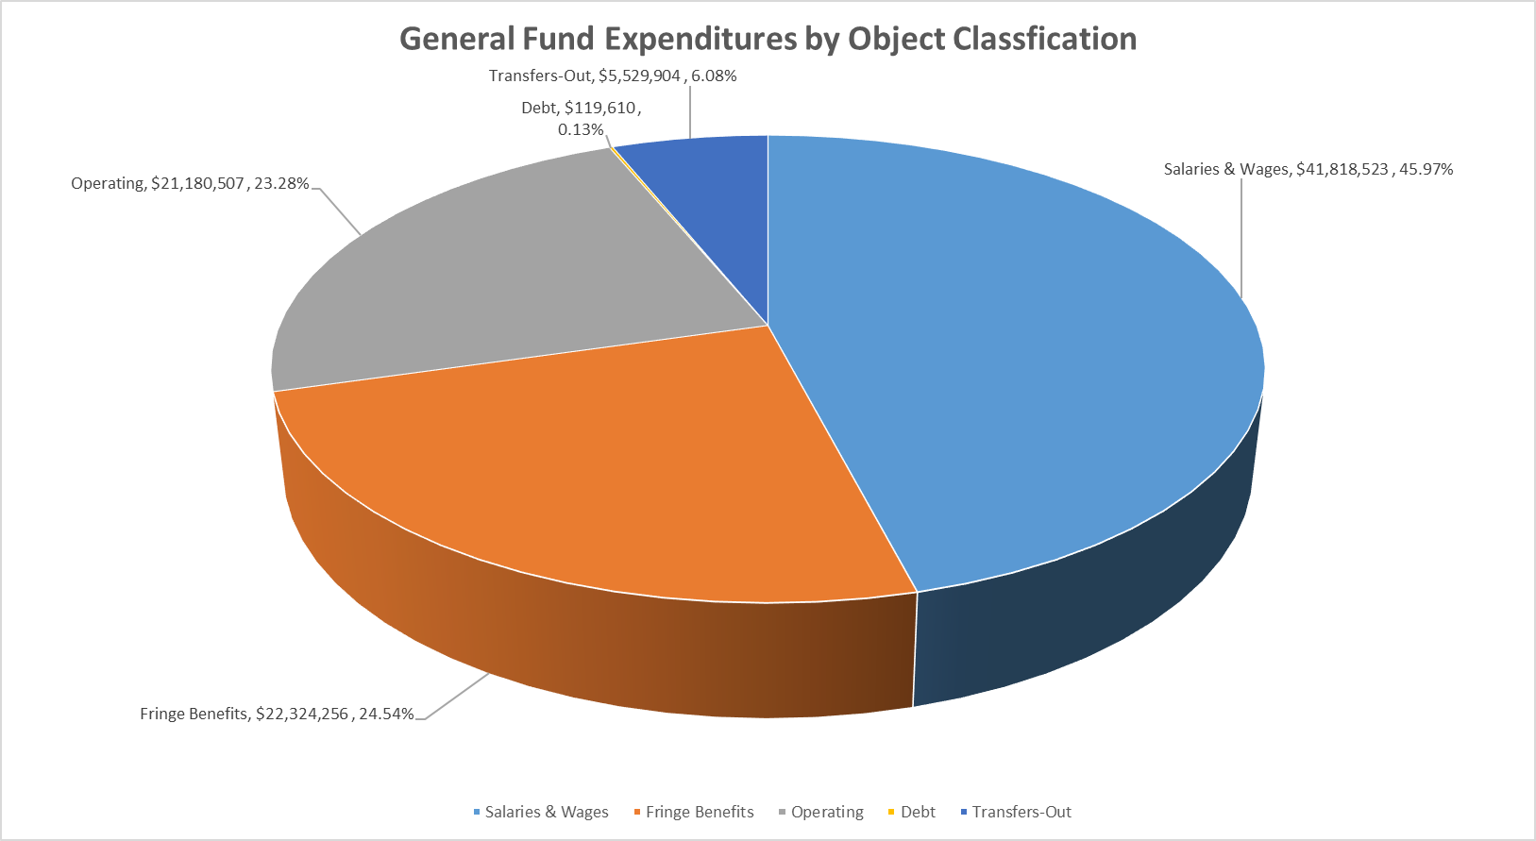
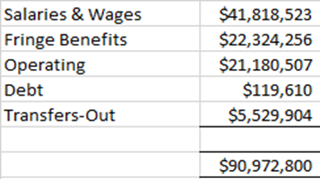
Notes:
Personnel makes up 70%+ of the entire budget.

Slide 9
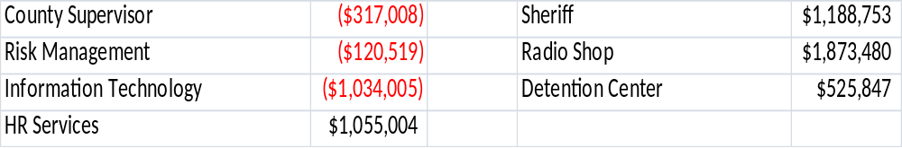
FY20 Departmental Highlights

Slide 10
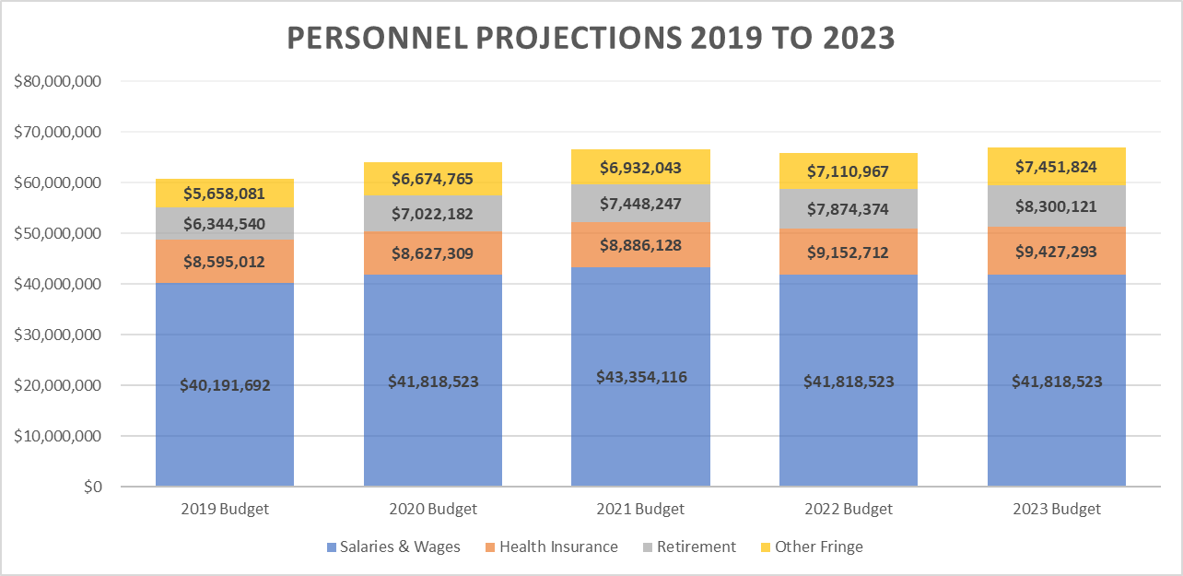
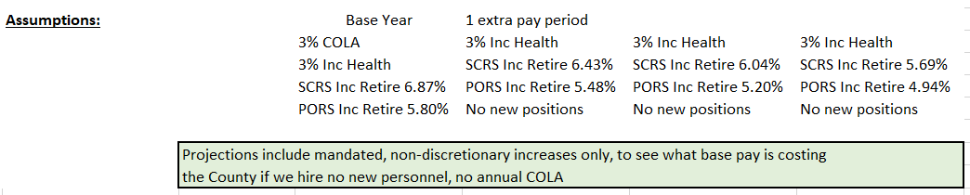
$66,620,534
$65,956,577
$66,997,762
$60,789,325
$64,142,779

Slide 11
FY 20 Recommended New Personnel
FY19-20 budget includes:
  Personnel – 18 New Positions
    11.5 New General Fund positions (all funded 75% of FY)
      1 – Solicitor, Coor Drug Court/Mental Health
      1 – Coroner, Deputy Coroner
      8 – Sheriff
        4 Deputy Sheriffs
        4 Corporals
      0.5 – Engineering
        .25 Engineering Tech (25% GF, 75% Sales Tax)
        .25 Principal Engineer (25% GF, 75% Sales Tax)
      1 – Animal Center, Kennel Tech
    12 positions funded with 1 Cent Sales Tax***
    11 New Storm Water positions
Notes:
1 – Solicitor, Coor Drug Court/Mental Health ($60,433.73 Sal & Bene)
1 – Coroner, Deputy Coroner ($45,644.67 Sal & Bene)
8 – Sheriff
4 Deputy Sheriff ($48,367.79 x 4 = $193,471.16 Sal & Bene)
4 Corporal ($50,432.12 x 4 = $201,728.48 Sal & Bene)
2 – Engineering
1 Engineering Tech ($58,348.22 – 25% GF, 75% Sales Tax)
1 Principal Engineer ($73,935.85 - 25% GF, 75% Sales Tax)
1 – Animal Center, Kennel Tech ($33,109.95 Sal & Bene)
Points of Interest:
*Engineers will be doing in-house design. Just two projects will more than pay for the cost of having them in-house versus contracting the work out. They are listed here and under the next section because only
25% of their funding comes from the general fund. The remaining 1.5 or 75% of their funding comes from sales tax.
*

Slide 12
FY 20 Recommended New Personnel
Personnel Continued:
    1 New Economic Development position (funded 100% of FY & funded by Eco Dev)
      1 – Manager of Existing Industry/Business Retention
    2 New Cypress Gardens Positions (funded 75% of FY & funded by Cypress Gardens)
      1 – Horticulturist
      1 – Admin Supp Spec
    Grants – New Dept (funded 25% of FY & funded by CDBG Grant)
      1 – CDBG Grants Administrator
    Tourism – New Dept (funded 75% of FY & funded by Accommodations Tax)
      1 – Tourism Director
    1.5 – Engineering
        .75 Engineering Tech (25% GF, 75% Sales Tax)
        .75 Principal Engineer (25% GF, 75% Sales Tax)
Notes:
1 New Economic Development position (funded 100% of FY & funded by Eco Dev)
1 – Manager of Existing Industry/Business Retention ($111,673.10 Sal & Bene)
2 New Cypress Gardens Positions (funded 75% of FY & funded by Cypress Gardens)
1 – Horticulturist ($45,817.11 Sal & Bene)
1 – Admin Supp Spec ($34,679.91 Sal & Bene)
Grants – New Dept (funded 25% of FY & funded by CDBG Grant)
1 – CDBG Grants Administrator ($22,685.54 Sal & Bene)
Tourism – New Dept (funded 75% of FY & funded by Accommodations Tax)
1 – Tourism Director ($68,130.02 Sal & Bene)
Points of Interest:
*The Cypress Gardens positions existed before the facility had to close so technically, they aren’t “new” positions. However, they haven’t been funded in some time now since the park was closed.
*The Grants position will be funded by general fund for only 25% of this fiscal year and then by the CDBG grant. We will try and seek reimbursement of the 25% as well.
*Remaining 75% of the engineering positions are shown here and make up 1.5 new positions.

Slide 13
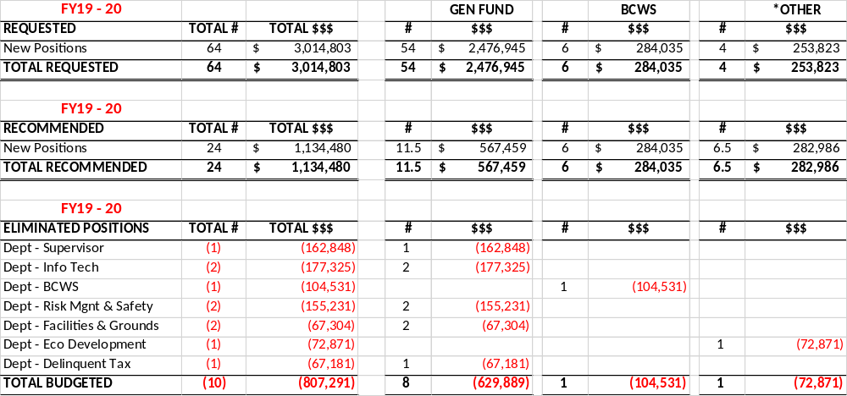
FY20 Personnel – New Positions
Requested vs Recommended
*Other includes:
2 Cypress Gardens
1 Eco Dev
1 Accommodations
1.5 Sales Tax
1 CDBG
Notes:
Points of Interest:
*Note that the general fund eliminated more personnel dollars than they added.

Slide 14
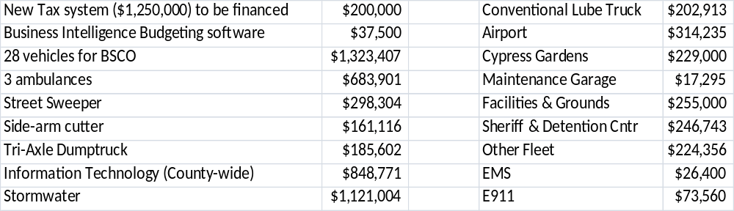
FY20 Capital Expenditures
Budget philosophy: “Live within your means”
  Annual 20% of LOST revenues equates to approx. $4,000,000
    General Fund Requested items = $7,692,034
    General Fund Funded items = $4,069,238
    Special Revenue Requested items = $3,046,330
    Special Revenue Funded items = $2,299,163
  Key initiatives and items recommended for funding:

Slide 15
Information Technology & Services
Removed two positions, Senior Infrastructure Specialist & desktop support technician.
Replaced (on-going) hosted VoIP system which amounted to $339,000 /year. New system will cost $15,000 and managed in house.
Workflow Project: Eliminated the need for recurring software cost(s) associated with lifecycle and retention schedules. ~$75,000 /year
Reduced workstation replacement schedule. ~$30,000 (re-evaluate the scheduled replacement this year)
Surveillance in place of non-intelligent access control systems reducing infrastructure improvement request(s) by ~$30,000

Slide 16
Information Technology & Services
Eliminated two cabling devices @ ~$39,000 (will place verbiage in contracts to ensure the hired contractors provide cabling certifications upon completion of their scope)
Redundant request for EMS APX radios in the amount of ~$118,000.
AS400 Replacement Plan: Initial request was for hardware and services in the amount of $159,000. We will lower this amount to $59,000 for equipment only.
Backup request eliminated: We have found a method to do this efficiently in house; ~$63,000
Re-evaluated needs for EMS Tablets, eliminating 30 units = ~$89,000

Slide 17
Information Technology & Services
Radio Shop
  Our newly created Radio Shop Department now is home to all communication expenses in the county.
  Largest expense of $1,500,000 yearly for radio maintenance for Public Safety radio system. This is captured for the first time in our budget.

Slide 18
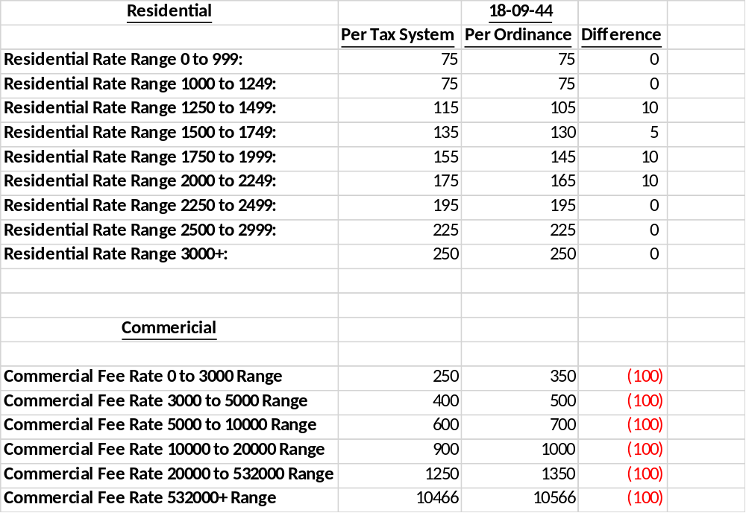
FY20 Fire Fees

Slide 19
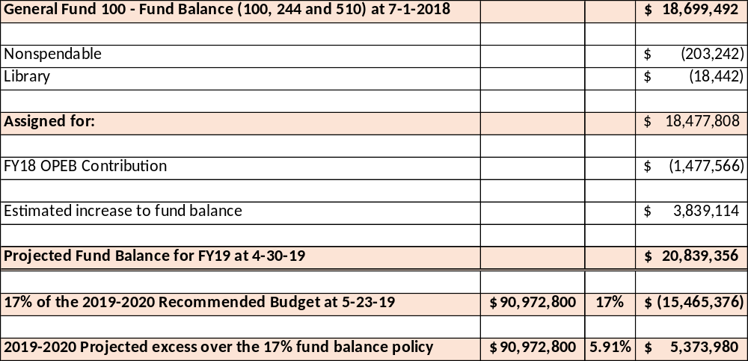
Fund Balance – General Fund
Notes:
Make a point to discuss the following:
***$3.8M is mostly from the correction involving moving the Reg of Deed funds to the correct location.
Courthouse
Jail
Evidence Room
Food Lion Expansion
Existing facility Improvements

Slide 20
Water & Sanitation
FY 19-20 Budget
Fiscal Year 2020
Recommended Budget

Slide 21
FY20 Budget Highlights-BCWS
Water & Sewer
  Includes the following Rate Changes:
    Water Rate Increase
      Assumes 5% increase in water rates - appx $636k of new revenue
        Current rate = $4.58/1000gals. New rate would be $4.81/1000gals.
        Represents an increase of $1.83/mth for an 8,000/gal user
          Previous increase of 15% FY17-18 and 10% FY18-19 base on rate study indicating 40% needed)
    Sewer Impact Fee Increase
      Assumes an increase in the Sewer User Fee from $2,500 to $2,850
        Est Revenue = $490,000 to Fund R&R
Notes:
*Rate study recommended 40% increase and council agreed to a 30% increase (originally) over 2 years. However, we approved a 10% last year and 25% the year prior to that.
*With this 5%, all funds are balanced independently and each is contributing to the R&R fund this year.
*Prior Rate was $4.16 + 10% increase took it to $4.58. Last years increase of 10% was a $3.88 increase per month for an 8,000/gal user.

Slide 22
FY20 Budget Highlights-BCWS
Water & Sewer Continued
    Personnel
      6 New Positions (funded 75% of FY) = $284,035.35
        1 Engineer III-In House Designer
        1 Wastewater Technician 1
        1 Wastewater Utility Locator
        2 Pump & Plant Maintenance Mechanic 1
        1 Building & Fleet Mechanic
Notes:
Water & Sewer Continued
Personnel
6 New Positions (funded 75% of FY) = $284,035.35
1 Engineer III-In House Designer ($65,264.02 w bene)
1 Wastewater Technician 1 ($42,029.85 w bene)
1 Wastewater Utility Locator ($47,540.06 w bene)
2 Pump & Plant Maintenance Mechanic 1 ($41,707.62 x 2 = $83,415.24 w bene)
1 Building & Fleet Mechanic ($45,786.17 w bene)

Slide 23
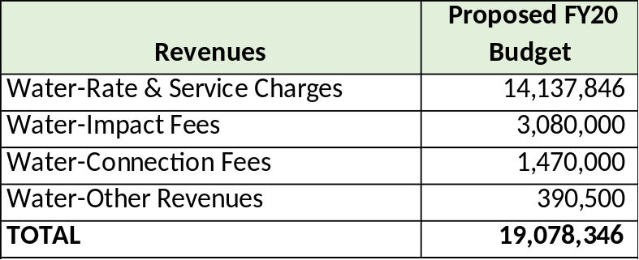
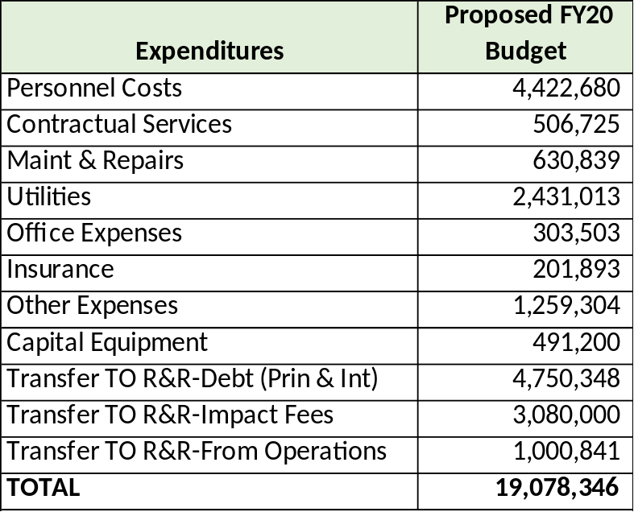
FY20 Proposed Budget - Water
Notes:
*Impact and Connection Fees budgeted at same level as FY19 anticipating some flattening in collections.
*You can see 100% of the impact fees and revenue from the rate increases going to R&R as well.

Slide 24
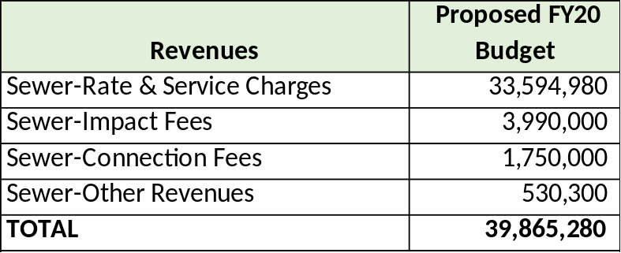
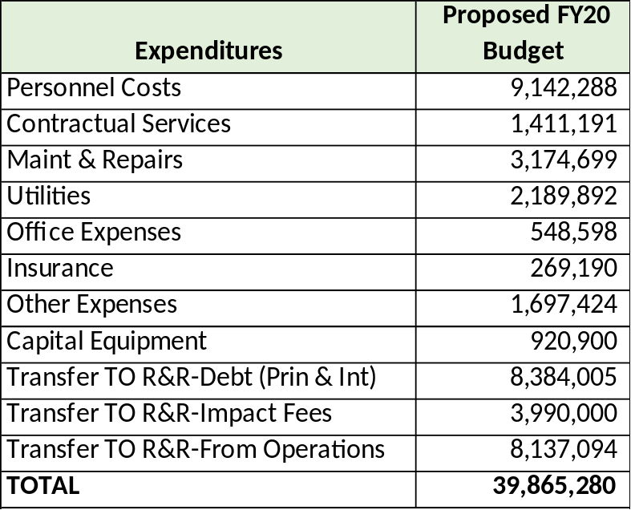
FY20 Proposed Budget - Sewer
Notes:
*We budgeted the same NUMBER of impact fees for the FY20 year as we did in FY19, but with the proposed increase in impact fees, this increases that revenue line item from $3.5M to almost $4M, all of which goes to the R&R fund.
*The transfer from operations is more than last year primarily due to not having to budget for the debt service for the treatment plant expansion until next year and reduced capital equipment expense for FY20.

Slide 25
FY20 Budget Highlights-BCWS
Solid Waste
  Includes
    Major Changes due to RePower South (RPS)
      New Revenue due to RPS
        $2,272,800 budgeted for Residual into the landfill (min per Contract is $1,545,504)
          $1,545,504 represents 34% of 120k tons @ $37.88/Ton)
        $950,000 Lease from RPS to BCWS
        ($455,000) reduction in revenue from sewer fund for sludge disposal
      New Expense due to RPS
        $4,545,600 in Users Fees will be paid to RPS (total SWUF revenue est’d @ $8,850,000)
        $525,000 budgeted to manage hauling 7,000 tons of sludge to another location TBD
          10,000 tons total, but we plan to still put appx 3,000 tons in the landfill
Notes:
*Changes the budget landscape for Solid Waste.
*May need to make adjustments during the year
*Budget is based on what we know regarding the contractual agreement at this time.

Slide 26
FY20 Budget Highlights-BCWS
Solid Waste Continued
    Personnel
      No new positions or upgrades
      3% COLA/Merit for 6 months beginning January 20’

Slide 27
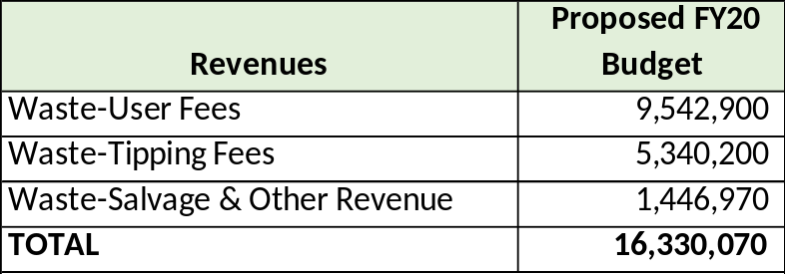
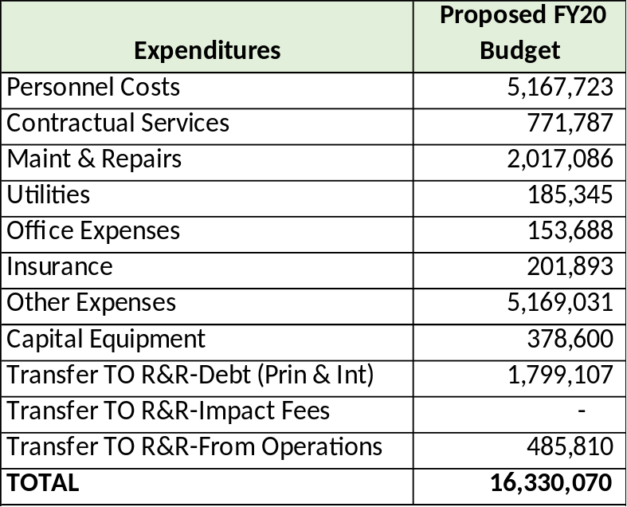
FY20 Proposed Budget – Solid Waste
Notes:
*Revenue – Increase in revenue primarily due to lease and residual payments from RePower.
*Increase in expenses in the “Other Expenses” category which includes “Other Professional Services”. This is where the $4.5M increase in expense is budgeted for RePower.
*User Fees - Estimating 75,971 Residential @ $75, 12,196 Multi-Family @ $75 and 4,383 Commercial @ $85.
*Land Lease is $950,000 ($79,166.67 per month) from RePower.
*Residual Fee is $128,750 per month at minimum ($1,545,000) and based on the contractual agreement of 34% of the 120k tons we send to them.
Expense
*Capital Equipment requests were kept to a minimum until we see the impact from RePower.

Slide 28
FY20 Budget Highlights-BCWS
  R&R Fund
    Budgeted Contribution for FY20 = $31,627,204
      Impact Fees = $7,070,000
      From Operating for Debt = $14,933,459
      From Operation Add’l = $9,623,745
    Does not include State Revolving Fund (SRF) for Sewer Treatment Plant Upgrades
      $40M estimated from SRF to fund Sewer Treatment Plant Upgrades
        Debt service will not need to be budgeted until next FY. This freed up $1.4M to add to R&R during this FY
    Budgeted FY20 CIP expense = $98,157,120 (assuming all projects are completed)
    Estimated R&R balance at 6/30/20 = $18,805,225
      Assumes increase in Water Rate, collections meet or exceed budgeted expectations and SRF loan revenue for treatment plant upgrades.
Notes:
*We have been exceeding our impact fee collections for the past two years and that has helped with R&R funding since 100% of these revenues go to R&R directly.
*These impact fees may begin to slow at some point, so the rate increases are designed to allow us to continue to contribute to R&R from the operating funds as well.

Slide 29
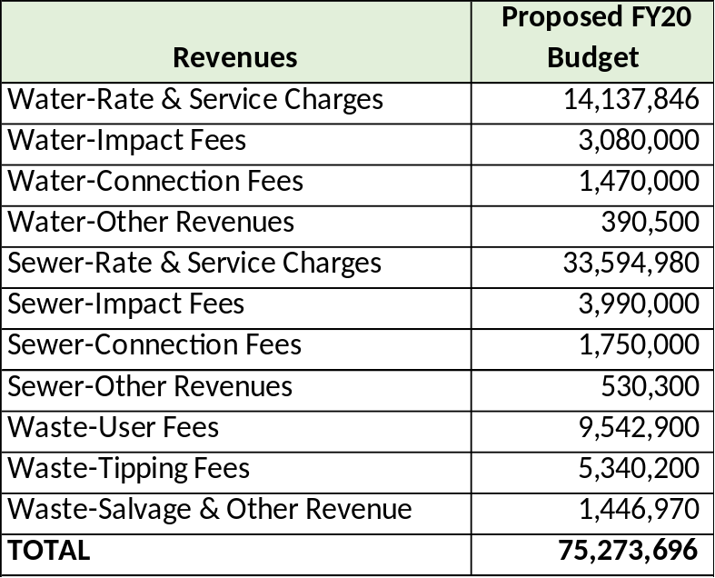

FY20 Budget Highlights-BCWS
Budget is balanced as follows:

Slide 30
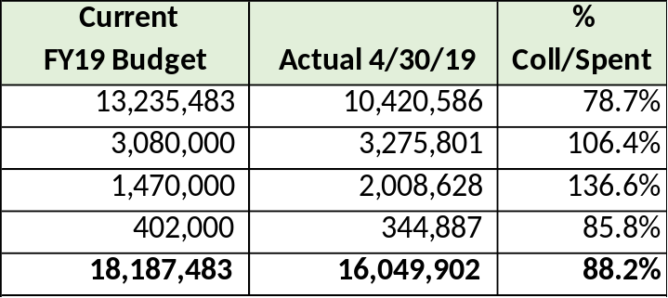
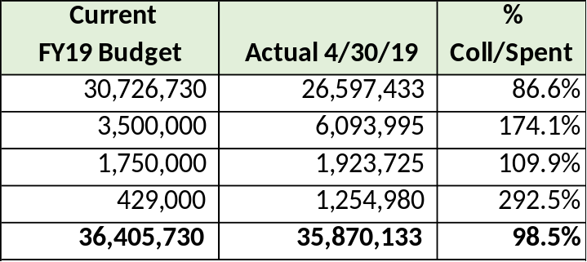
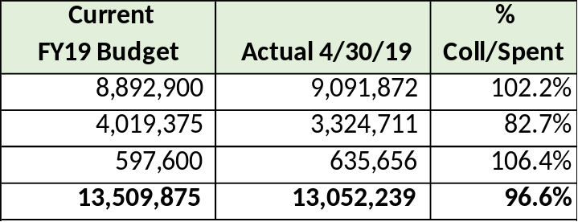
FY20 Proposed Revenue - BCWS
(as of April 2019)
Notes:
*Water-Increase in rate and service charges due to 5% rate increase
Rate revenue is a bit under the 83.3% we should be at, but the rate increase was implemented late due to the budget passing late last year.
*Sewer – Increase in rate revenue represents the growth in customers anticipated (about 6%)
Impact fee increase can be seen here.
*Solid Waste – User fee increase is anticipated customer growth
Tipping fee increase is primarily due to RePower residual payment of $1.45M.

Slide 31
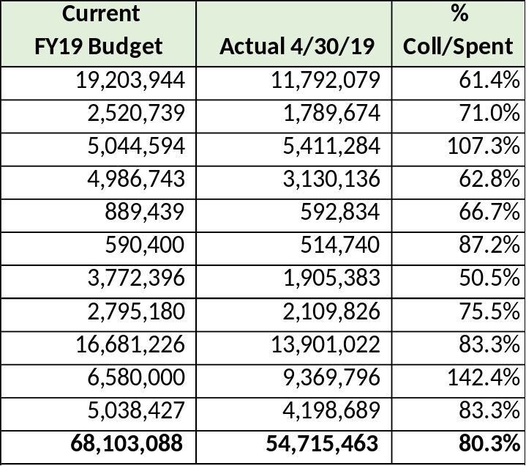
FY20 Proposed Expense - BCWS
(as of April 2019)
Notes:
Shared Portion of personnel for BCWS was reduced this year (orig was about $2.5M now about $2.2 and a management level position was eliminated.
Other Expense increased primarily due to the RePower South $4.5M+ payment in Other Professional Services for Solid Waste.
Transfer to R&R from Operating will increase temporarily this year due primarily to the reduction in debt service and less capital equipment expense for FY20.

